Slide 1


<Name>
<Date>

Slide 2

Outline
Executive Summary
Introduction
Methodology
Exploratory Data Analysis
Conclusion
Appendix
Dashboard
Predictive Analysis

Slide 3



Executive Summary
Methodology
Data from SpaceX launch and return was analyzed to build a model. The model can predict successful recovery of launch module after successful launch
Results
The results show that we have a model which shows an accuracy score of 88.75% in predicting the recovery of the launch module

Slide 4


Introduction
Most space launch vehicles which put satellites into orbit around the world are one-time use vehicles.
Due to this the cost of most launches are around $165 million or higher
However, SpaceX has pioneered reusable launchers. The first stage of these launchers return back to earth after use and can be reused after landing successfully
Reuse of launcher vehicles brings down the cost of satellite launches. SpaceX can thus advertise a cost as low as $62 million per launch
However, not all launch vehicles successfully result in return of the first stage. Multiple factors complicate the successful landing and return of the launcher’s 1st stage.
We can analyse these factors and build a predictive model which will predict if a launch has the factors necessary to be reusable
This model can later be used to predict a reasonable cost for each type of satellite launch depending on their success rate

Slide 5

Section 1

Slide 6

Methodology
Executive Summary
Data collection methodology:
Data was collected using SpaceX APIs and Data scraping from Wikipedia
Perform data wrangling
The status string was classified as Success or Fail (1 or 0)
Perform exploratory data analysis (EDA) using visualization and SQL
Perform interactive visual analytics using Folium and Plotly Dash
Perform predictive analysis using classification models
Grid Search Cross Validation was performed for 4 different classification models to estimate the best parameters

Slide 7
Data Collection
Data was collected using two sources:
SpaceX API. Using the REST protocol, a JSON string was obtained containing requested data
Data Scraping : Wikipedia page on the launch status of SpaceX launches was scraped for information
The two data sources can be either combined or one of them used, as there is duplicated information. The REST method was preferred
Notes:
Data scaping process
Directly downloading data using API and json

Slide 8
Data Collection – SpaceX API
launches
Spacex launch data is obtained from https://api.spacexdata.com/v4/launches/past as JSON data which is then converted to a dataframe
This dataframe has codes for rockets, launchpads, payloads and cores
The codes are used to obtain specific data, such as rockets from https://api.spacexdata.com/v4/rockets
This data from codes and launch data is combined, retaining only relevant fields
The data is cleaned for missing values and NULLs
For example, payload data which is missing is replaced by average payload
The notebook is available on github here:
rockets
launchpads
payloads
cores
getBoosterVersion()
getLaunchSite()
getPayloadData()
getCodeData()
Get data function()
Data Processing
Data out
Data Cleaning
Data save as csv
Notes:
To add – github link

Slide 9
Data Collection - Scraping
Website data can be parsed
BeautifulSoup (BS4) library in python can be used
The html website is broken up into hierarchical elements by BS4
These are accessed in accordance with their level of nesting
Contents such as text within the html tags can be accessed as data
Add the GitHub URL of the completed web scraping notebook, as an external reference and peer-review purpose
request.get(website.url)
BeautifulSoup
Hierarchical decomposition
Query DOM elements

Slide 10
Data Scraping Logic
get HTML page
Parse data using BeautifulSoup
.find_all(table)[#]
In our case # was 2
BeautifulSoup breaks down the html data into tag elements
Tables will be in <table> element that can be located by .find_all(‘table’) to get an array of table(s)
If there are more than one table, they can be accessed as index to array, like .find_all(‘table’)[2] to get the 2nd element
Header row is the <th> element and header columns are under the <th> element as <td> elements
All other rows are under the <tr> element and <td> columns.
Nested loops for outer row<tr> and inner column<td>
Header Definition
Find child <th>
Find child <td>
Empty dataframe df
df header[Col]=text()
Col++
Row Definition
n
<td>++?
y
Find child <tr>
Column
Definition
Find child <td>
Col++
y
df[Row][Col]=text()
<td>++?
n
Row++
<tr>++?
dataframe df w/ data
y
n

Slide 11
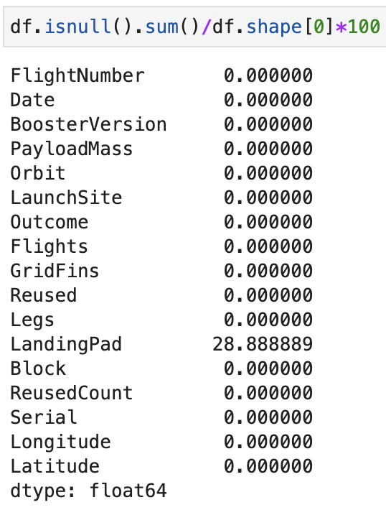
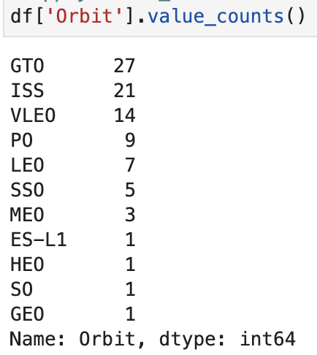
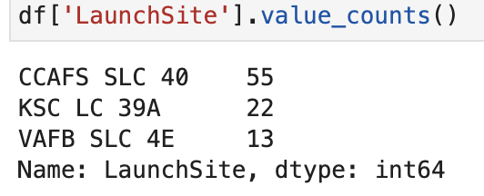
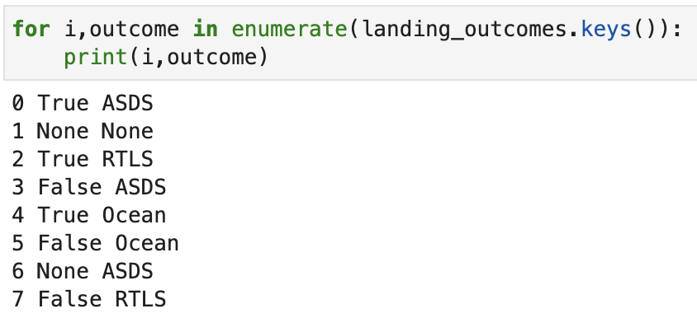
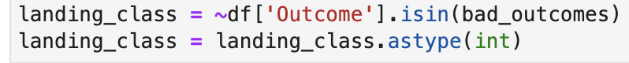
Data Wrangling
The data has NULL values
NULL values in Landing pad are removed
Orbital types
Calculate Number of launches on each site
Consolidate the mission outcome
Classify the mission outcome as a success (1) or failure(0)
1
3
2
4
5
Notes:
Since this is a course, the command is shown. Otherwise, this can be simply summarized as results, especially if this is presented.

Slide 12
EDA with Data Visualization
Exploratory data analysis was done to get trends or correlations:
Flight Number vs Launch Site
Payload vs Launch Site
Success Rate vs Orbit type
Flight Number vs Orbit type
Payload vs Orbit type
Launch Success Yearly trend
Add the GitHub URL of your completed EDA with data visualization notebook, as an external reference and peer-review purpose

Slide 13
EDA with SQL
Using bullet point format, summarize the SQL queries you performed
Add the GitHub URL of your completed EDA with SQL notebook, as an external reference and peer-review purpose

Slide 14
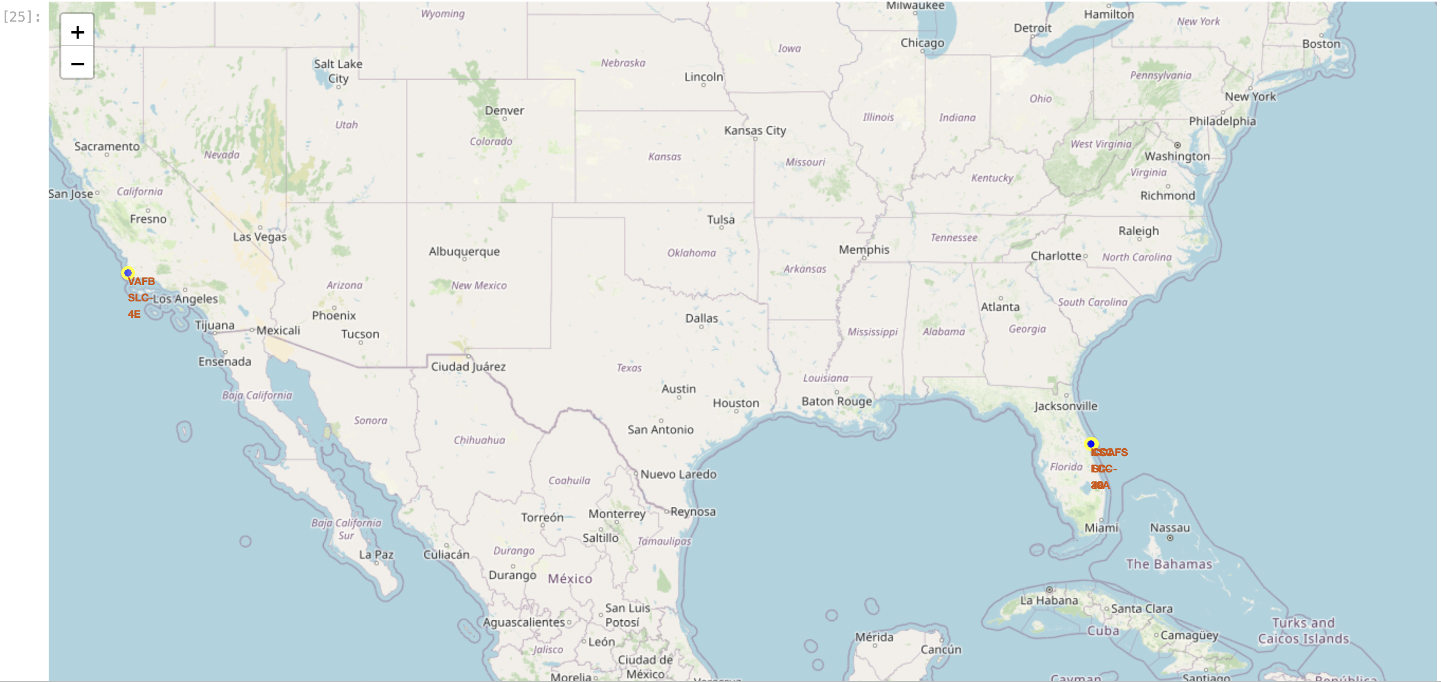
Build an Interactive Map with Folium
Summarize what map objects such as markers, circles, lines, etc. you created and added to a folium map
Explain why you added those objects
Add the GitHub URL of your completed interactive map with Folium map, as an external reference and peer-review purpose

Slide 15
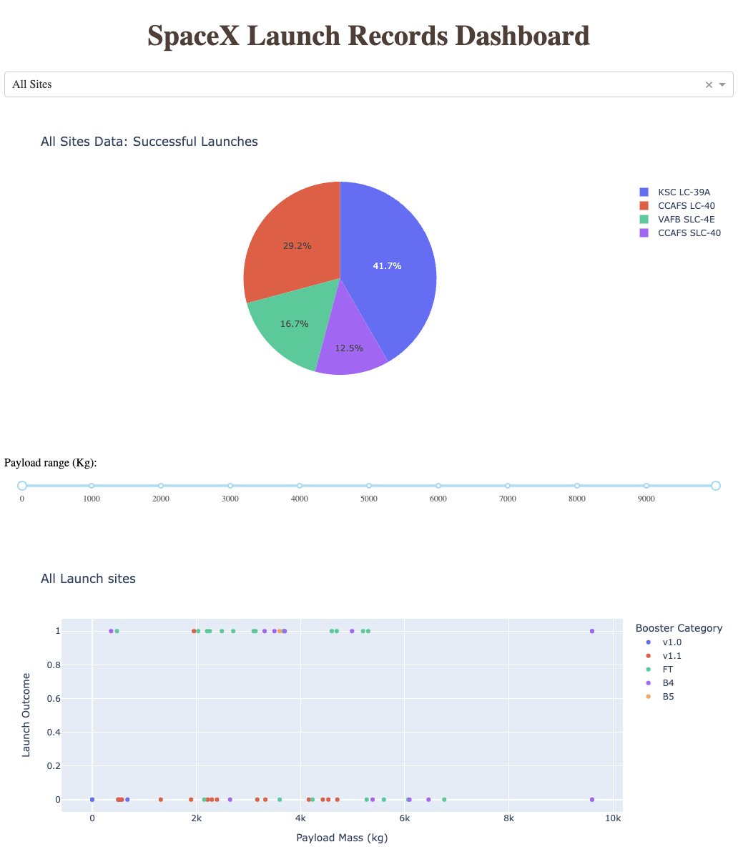
Dashboard with Plotly Dash
Summarize what plots/graphs and interactions you have added to a dashboard
Explain why you added those plots and interactions
Add the GitHub URL of your completed Plotly Dash lab, as an external reference and peer-review purpose

Slide 16
Predictive Analysis (Classification)
Summarize how you built, evaluated, improved, and found the best performing classification model
You need present your model development process using key phrases and flowchart
Add the GitHub URL of your completed predictive analysis lab, as an external reference and peer-review purpose

Slide 17

Results
Exploratory data analysis results
Interactive analytics demo in screenshots
Predictive analysis results

Slide 18

Section 2

Slide 19
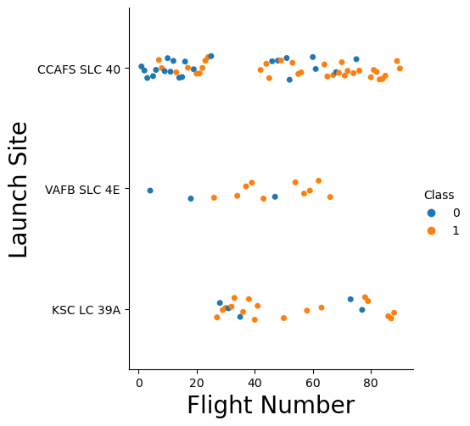
Flight Number vs. Launch Site
Show a scatter plot of Flight Number vs. Launch Site
Show the screenshot of the scatter plot with explanations

Slide 20
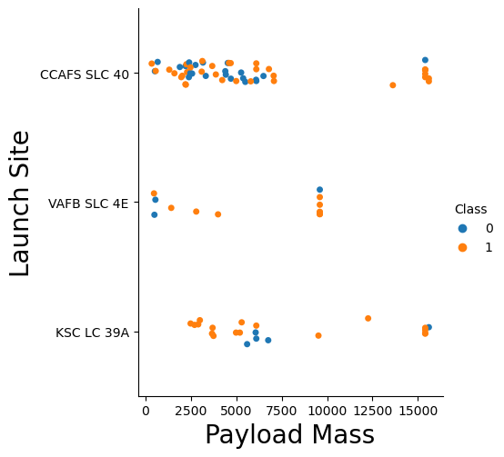
Payload vs. Launch Site
Show a scatter plot of Payload vs. Launch Site
Show the screenshot of the scatter plot with explanations

Slide 21
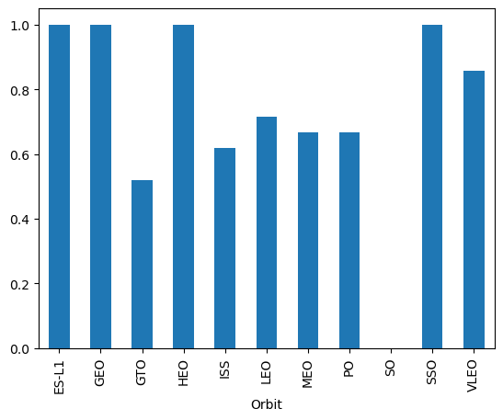
Success Rate vs. Orbit Type
Show a bar chart for the success rate of each orbit type
Show the screenshot of the scatter plot with explanations

Slide 22
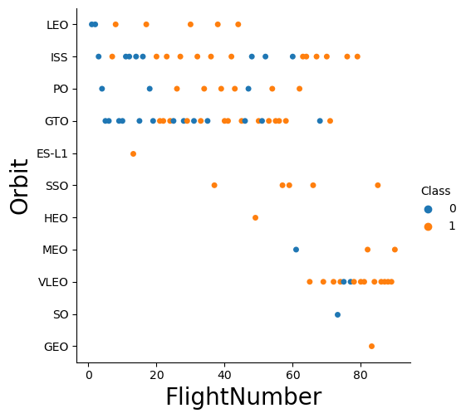
Flight Number vs. Orbit Type
Show a scatter point of Flight number vs. Orbit type
Show the screenshot of the scatter plot with explanations

Slide 23
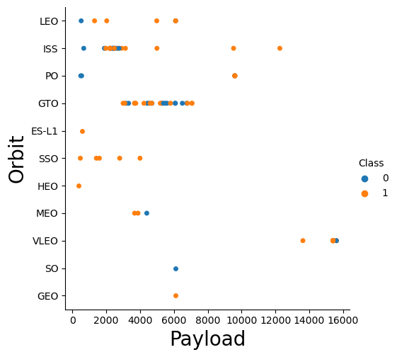
Payload vs. Orbit Type
Show a scatter point of payload vs. orbit type
Show the screenshot of the scatter plot with explanations

Slide 24
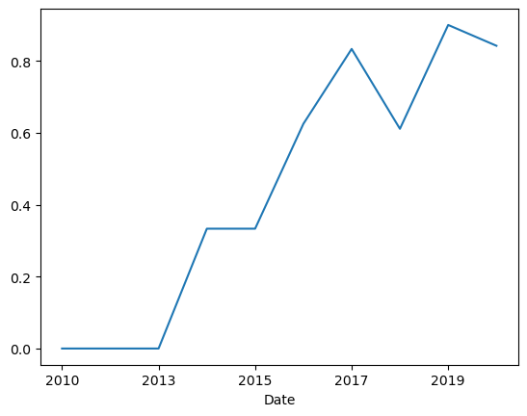
Launch Success Yearly Trend
Show a line chart of yearly average success rate
Show the screenshot of the scatter plot with explanations

Slide 25
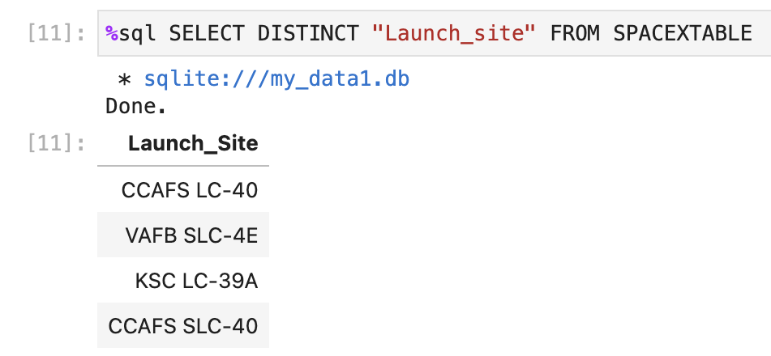
All Launch Site Names
The Launch sites have the following names:
CCAFS LC-40
VAFB SLC-4E
KSC LC-39A
CCAFS SLC-40
We can do this with SQL Queries.
The dataframe is loaded into an SQLite database and queries are run

Slide 26
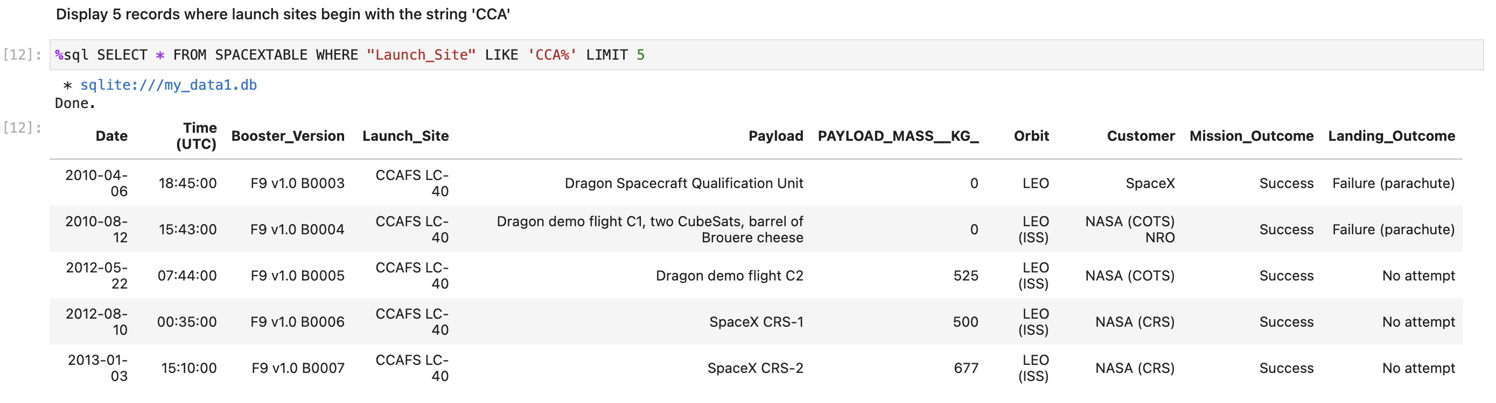
Launch Site Names Begin with 'CCA'
There are two launch sites beginning with CCA. We can look at a sample of the data from these launch sites. We can see the customer being either SpaceX or NASA

Slide 27
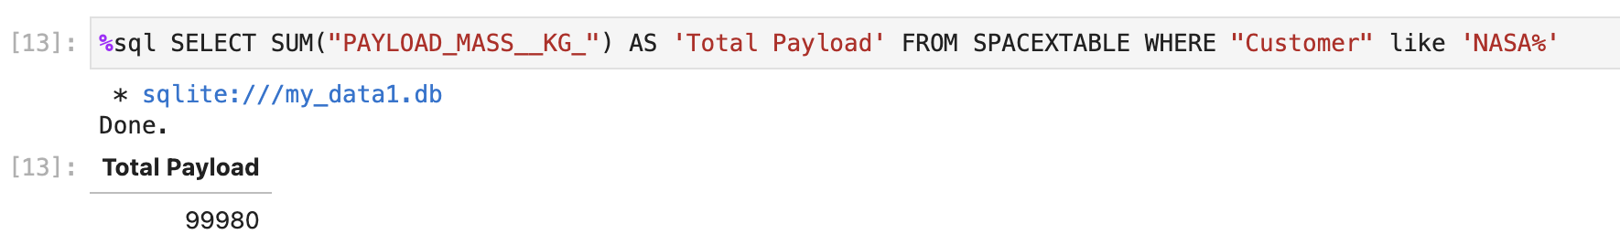
Total Payload Mass
The total payload carried by boosters for NASA is 99980 kg

Slide 28
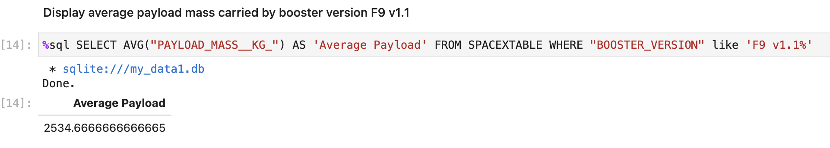
Average Payload Mass by F9 v1.1
The average payload mass carried by booster version F9 v1.1
The average is 2534.66 kg

Slide 29
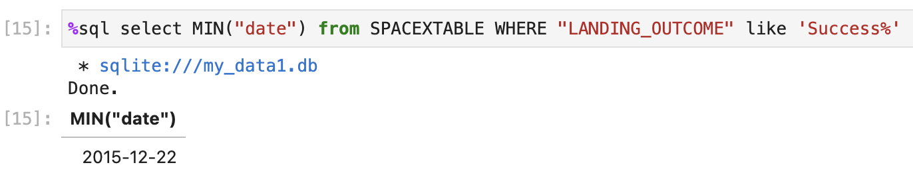
First Successful Ground Landing Date
The first successful Ground landing was done on 12-12-2015

Slide 30
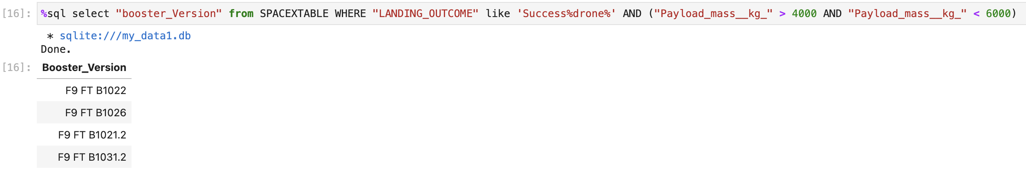
Successful Drone Ship Landing with Payload between 4000 and 6000
This provides the names of boosters which have successfully landed on drone ship and had payload mass greater than 4000 but less than 6000
The WHERE clause uses two Boolean parts, LANDING_OUTCOME starting with Success and a Boolean operation with Payload_mass_kg < 4000 and <6000. The BETWEEN _ AND _ clause can also be used

Slide 31
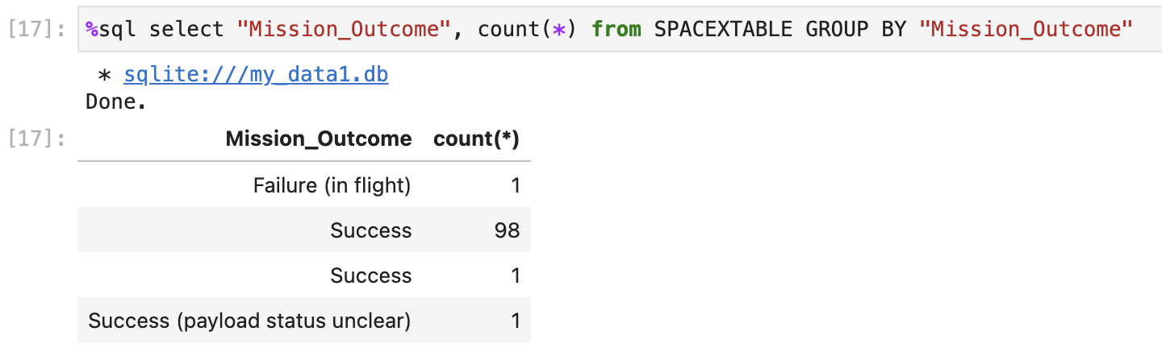
Total Number of Successful and Failure Mission Outcomes
The total number of Failure and Success of mission is given :-
Success = 98+1+1 = 100
Failure = 1

Slide 32
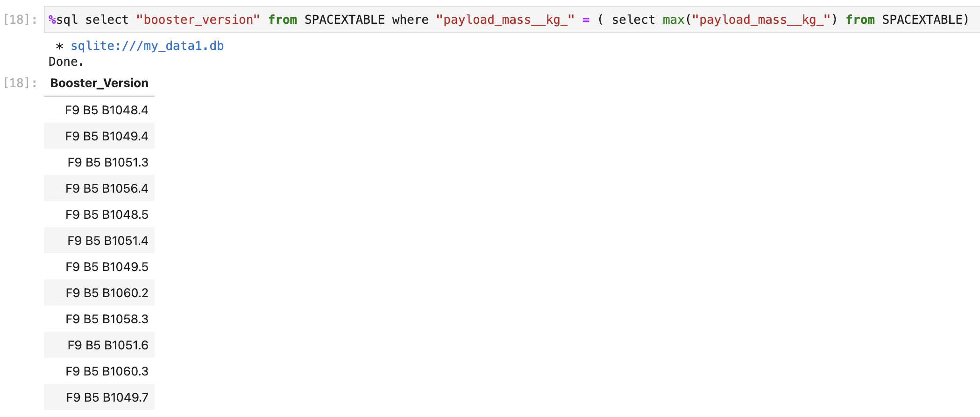
Boosters Carried Maximum Payload
These are the boosters which carry the maximum payload. All are variants of Falcon 9 heavy

Slide 33
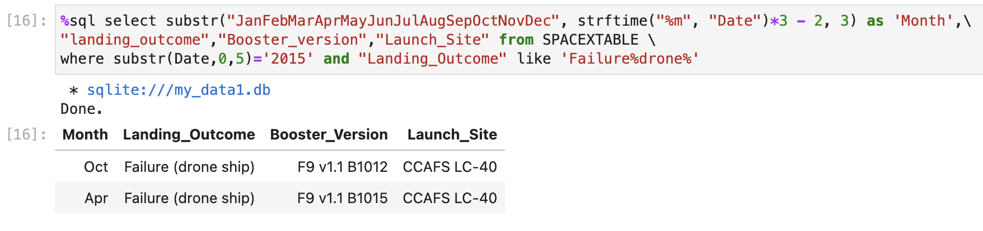
2015 Launch Records
We can list the failed landing outcomes, their booster versions and launch site names for a specific year, like 2015
Limitations of SQLite force us to use some string-based techniques to get the month name. A 3-letter month is obtained

Slide 34
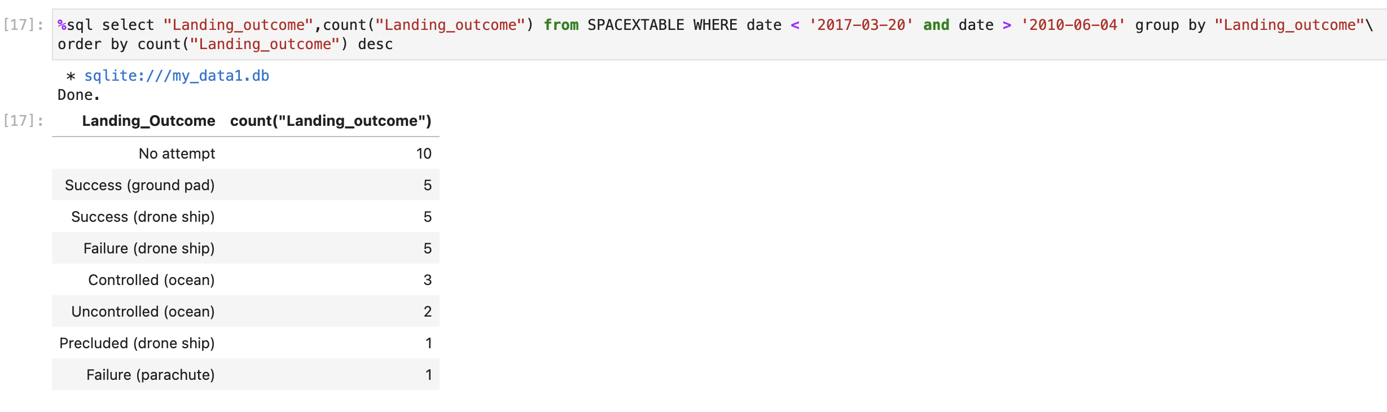
Rank Landing Outcomes Between 2010-06-04 and 2017-03-20
We can check the ranking of Landing Outcomes between 2010-06-04 and 2017-03-20, in descending order
We can see that no landing was attempted for 10 launching missions. 6 Failures have been noted, and 16 successful attempts

Slide 35

Section 3

Slide 36
Launch Sites
This map shows the position of the launch sites.
One site is on the west coast, while other three are on the east coast in Florida
The sites are close to the ocean

Slide 37
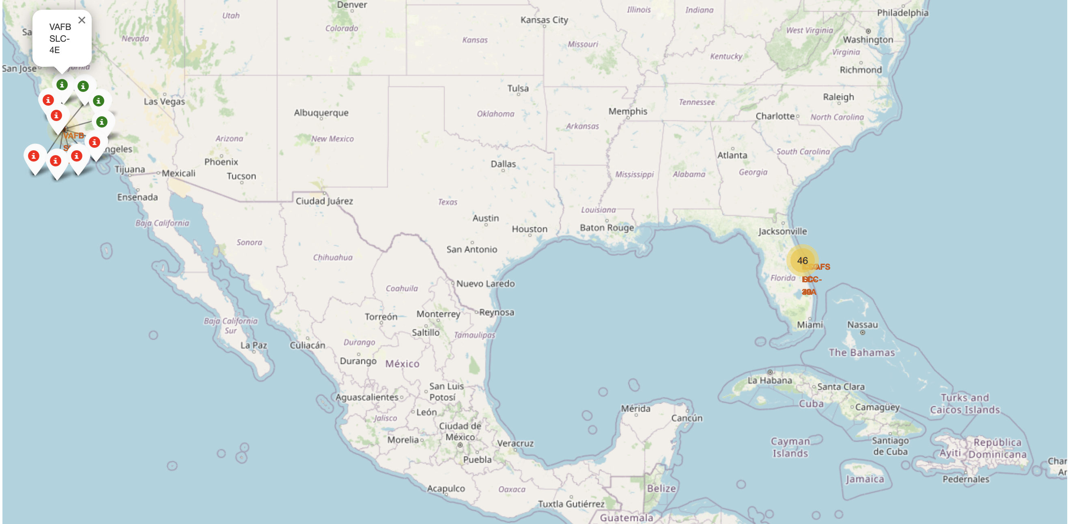
Launch Outcome
The map interactively shows positive launch outcomes with green markers and failed missions with red markers
The total number of missions launched are clustered near the site

Slide 38
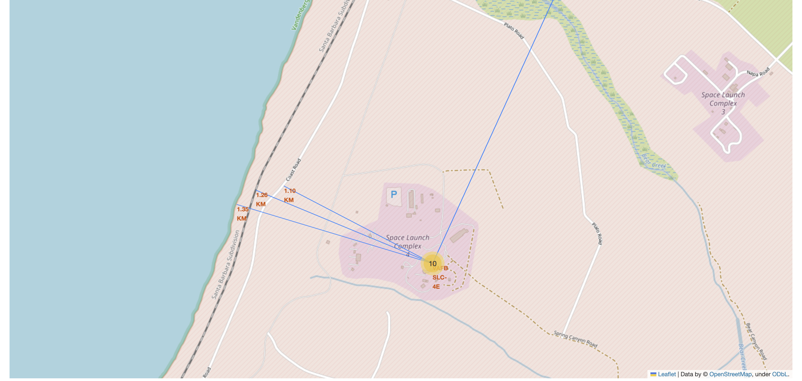
Launch Site proximity
The Launch sites are all close to the shoreline, and there are railway and road connections in its proximity
Large cities like Santa Maria on west coast (as in the map shown) or Orlando in Florida are much further away
These can be explained as follows:-
Launches go over the Ocean. Any failure can avoid populated areas
Rails and Roadways are close by, as logistics is required
Populated cities are far off, to minimize any casualties in case of failures

Slide 39

Section 4

Slide 40
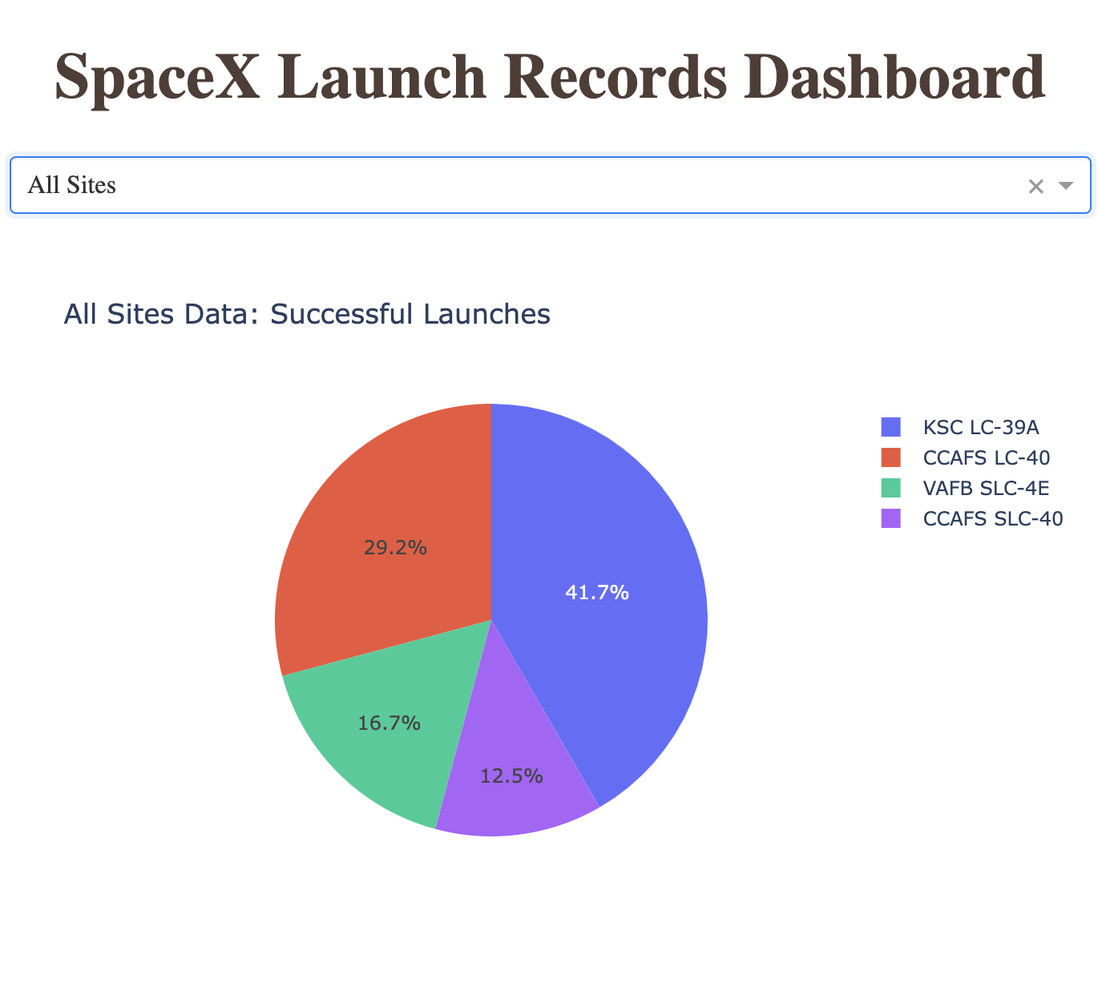
Successful Launches per site
The dashboard provides a dropdown which can choose “All Sites”
The Piechart shows KSC LC-39A having the highest success rate of 41.7%

Slide 41
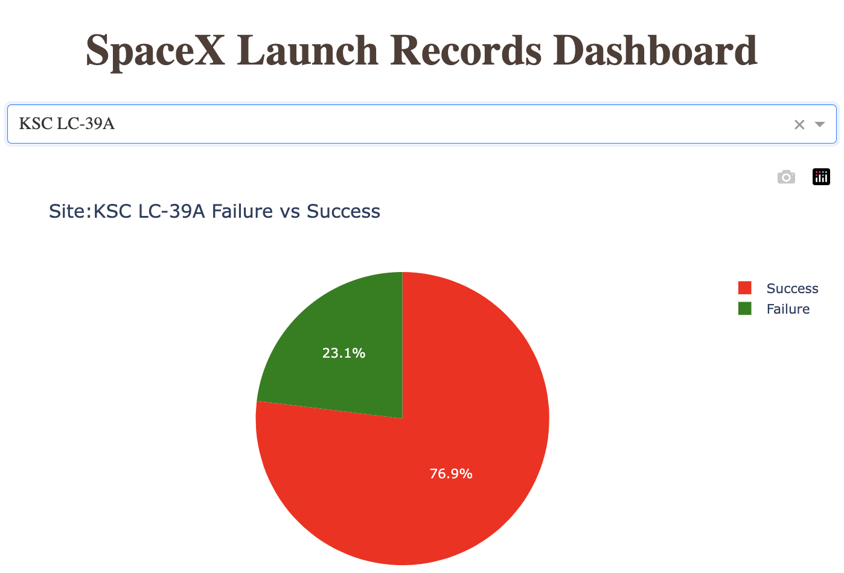
Success rate of the most productive launch site
The KSC LC-39A site shows the highest success rate compared to other sites
However, its actual success vs failure percentage is low : 23.1%
The CCAFS SLC-40 has a higher success rate of 42.9%
This is because KSC LC-39A has more launch attempts than CCAFS SLC-40

Slide 42
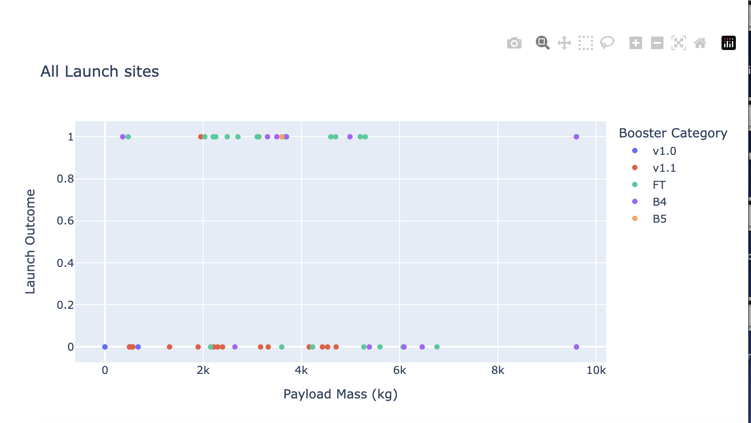
<Dashboard Screenshot 3>
Replace <Dashboard screenshot 3> title with an appropriate title
Show screenshots of Payload vs. Launch Outcome scatter plot for all sites, with different payload selected in the range slider
Explain the important elements and findings on the screenshot, such as which payload range or booster version have the largest success rate, etc.

Slide 43

Section 5

Slide 44
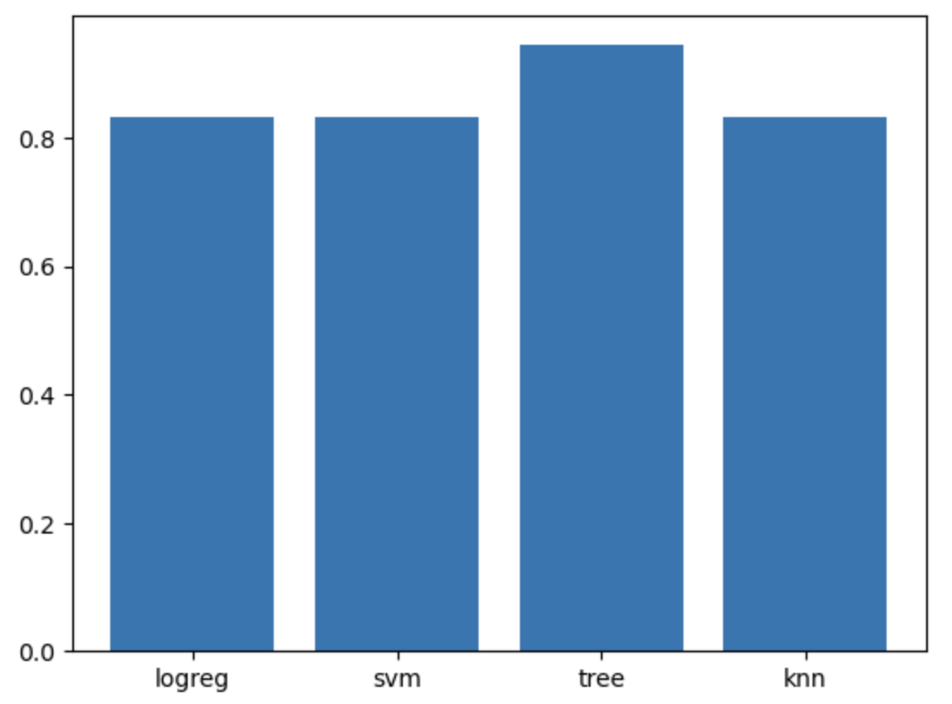
Classification Accuracy
Visualize the built model accuracy for all built classification models, in a bar chart
Find which model has the highest classification accuracy

Slide 45
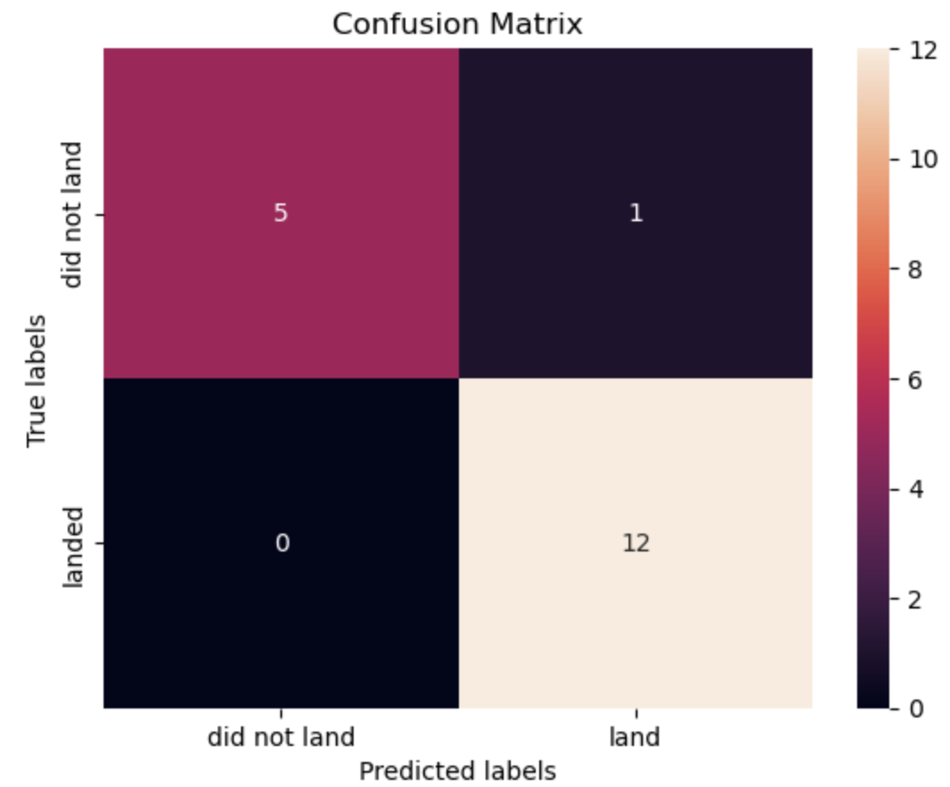
Confusion Matrix
Show the confusion matrix of the best performing model with an explanation

Slide 46

Conclusions
Point 1
Point 2
Point 3
Point 4
…

Slide 47

Appendix
Include any relevant assets like Python code snippets, SQL queries, charts, Notebook outputs, or data sets that you may have created during this project

Slide 48


